Slide 1
POLI CRISIS
ES TIEMPO DE ACTUAR
NOVIEMBRE, 2023

Slide 2
PERMACRISIS
POLICRISIS
PERMACRISIS | POLICRISIS

Slide 3
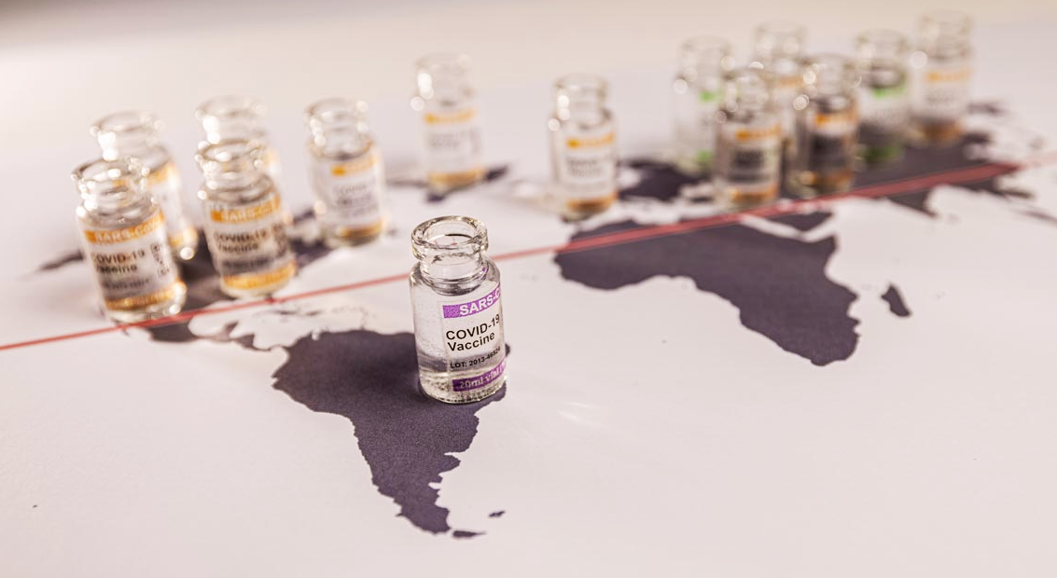
HEALTH CRISIS
Recuperado de: https://www.logicbus.com.mx/blog/por-que-la-cadena-de-frio-es-tan-importante-para-las-vacunas-2/

Slide 4
DEMOCRATIC CRISIS
Image: Atlantic Council

Slide 5
SOCIAL CRISIS
Recuperado de: https://elpais.com/internacional/2023-01-15/no-es-solo-brasil-la-erosion-global-de-la-democracia-avanza.html
Image: El País

Slide 6
FOOD CRISIS
Image: The Economist Time

Slide 7
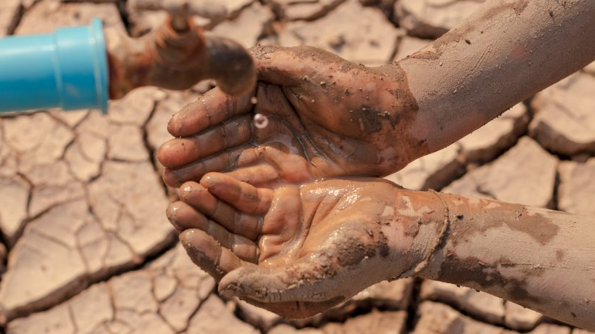
WATER CRISIS
Image: worldwildlife.org

Slide 8
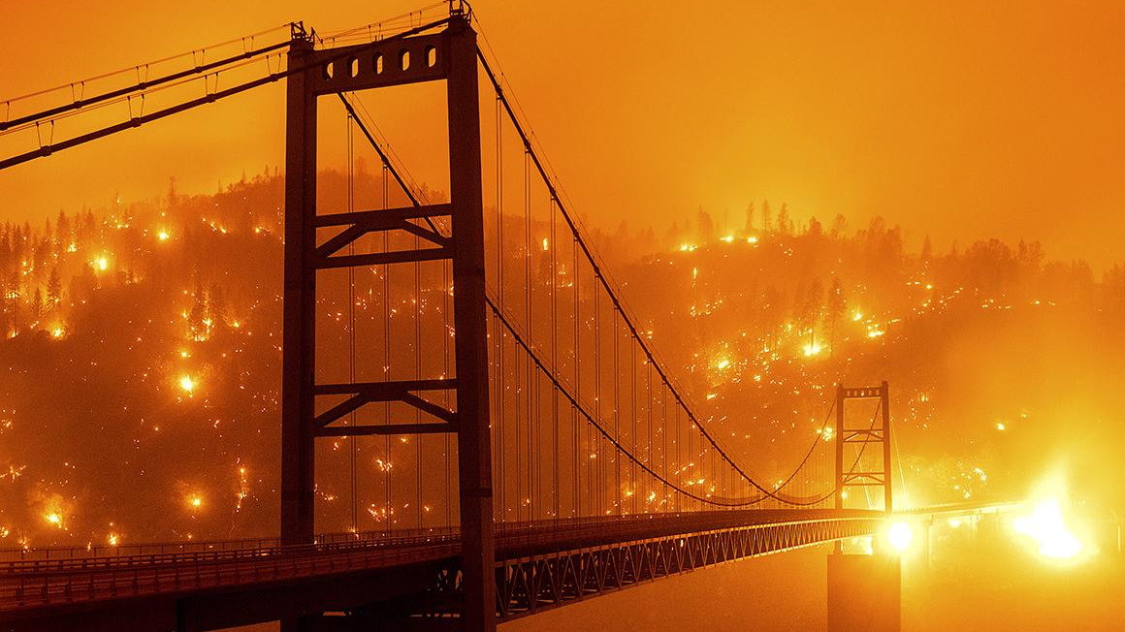
CLIMATE CRISIS
Image: AP - Noah Berger

Slide 9
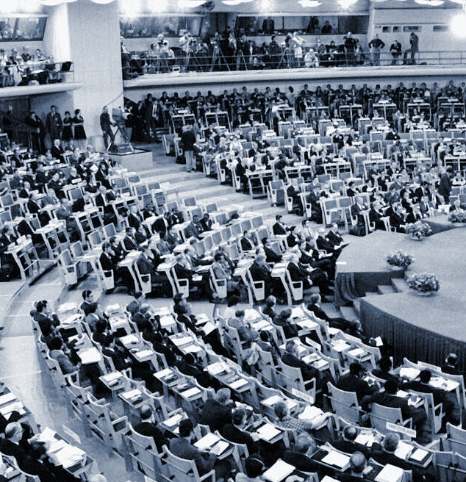
SUMMIT STOCKHOLM
BRUNDTLAND REPORT
1972
1987
“HOUSTON, WE HAVE A PROBLEM!”

Slide 10
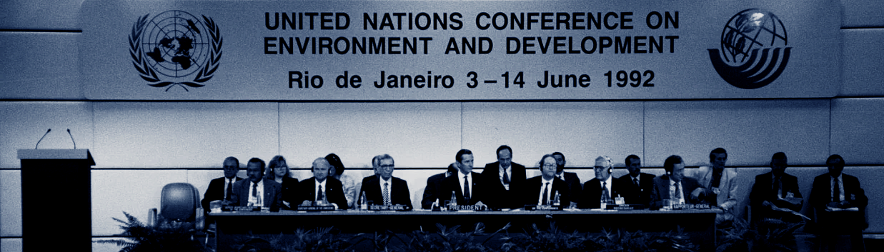
RIO EARTH SUMMIT
“HOUSTON, WE HAVE 3 PROBLEMS!”
1992

Slide 11
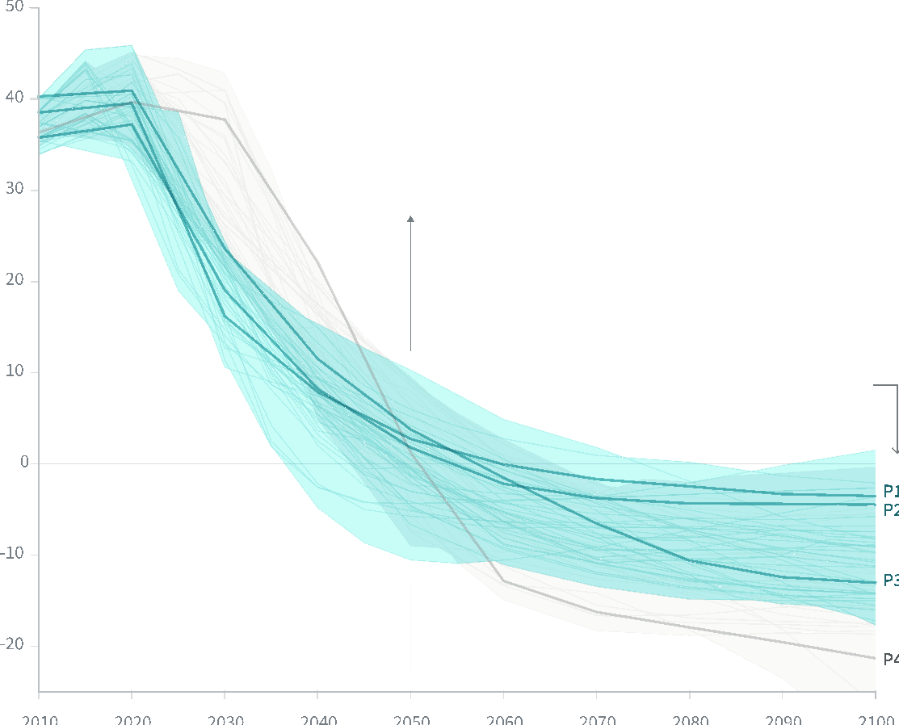
EMISIONES CO2 2010 - 2100
Billones de toneladas de CO2/año
2025
Peak de emisiones
2030
50% de reducción de emisiones
2050
Emisiones Netas Cero
2051-2100
Aumentar la capacidad de captura y secuestro
2010 2020 2030 2040 2050 2060 2070 2080 2090 2100

Slide 12
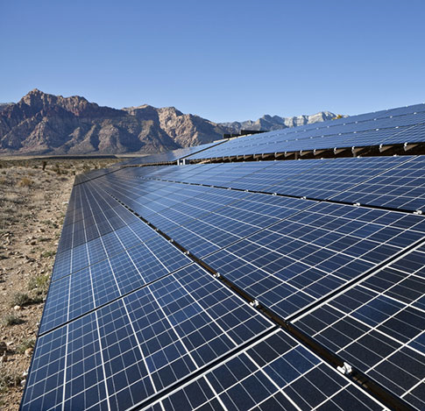
Credit: World Agroforestry Centre

Slide 14
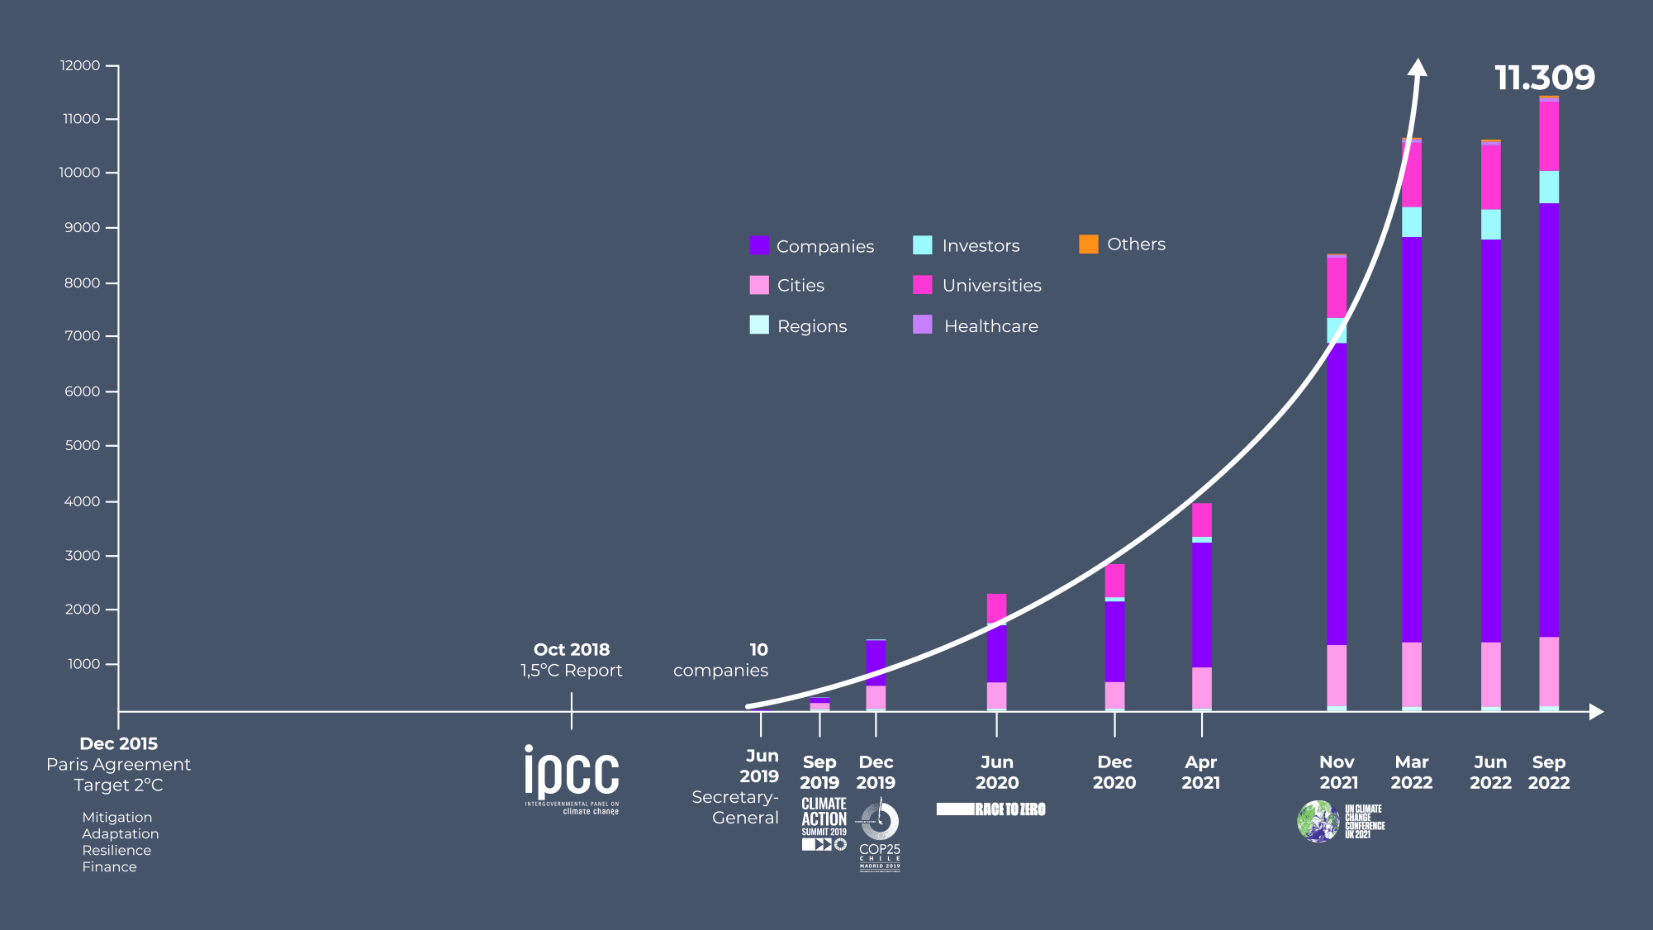
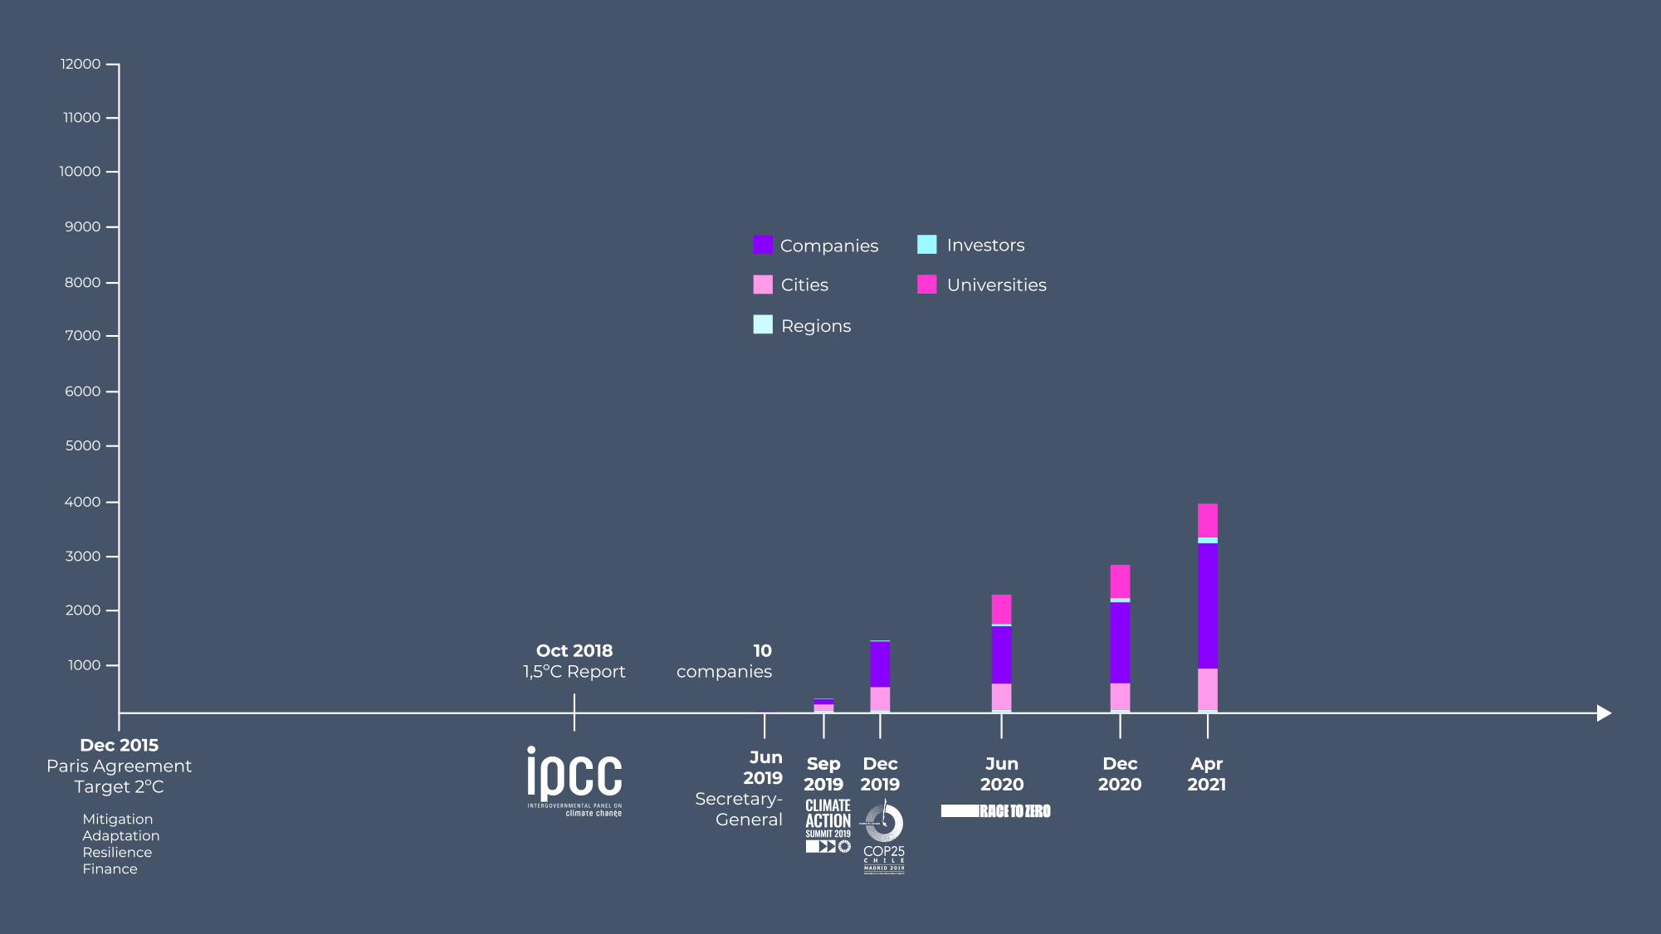
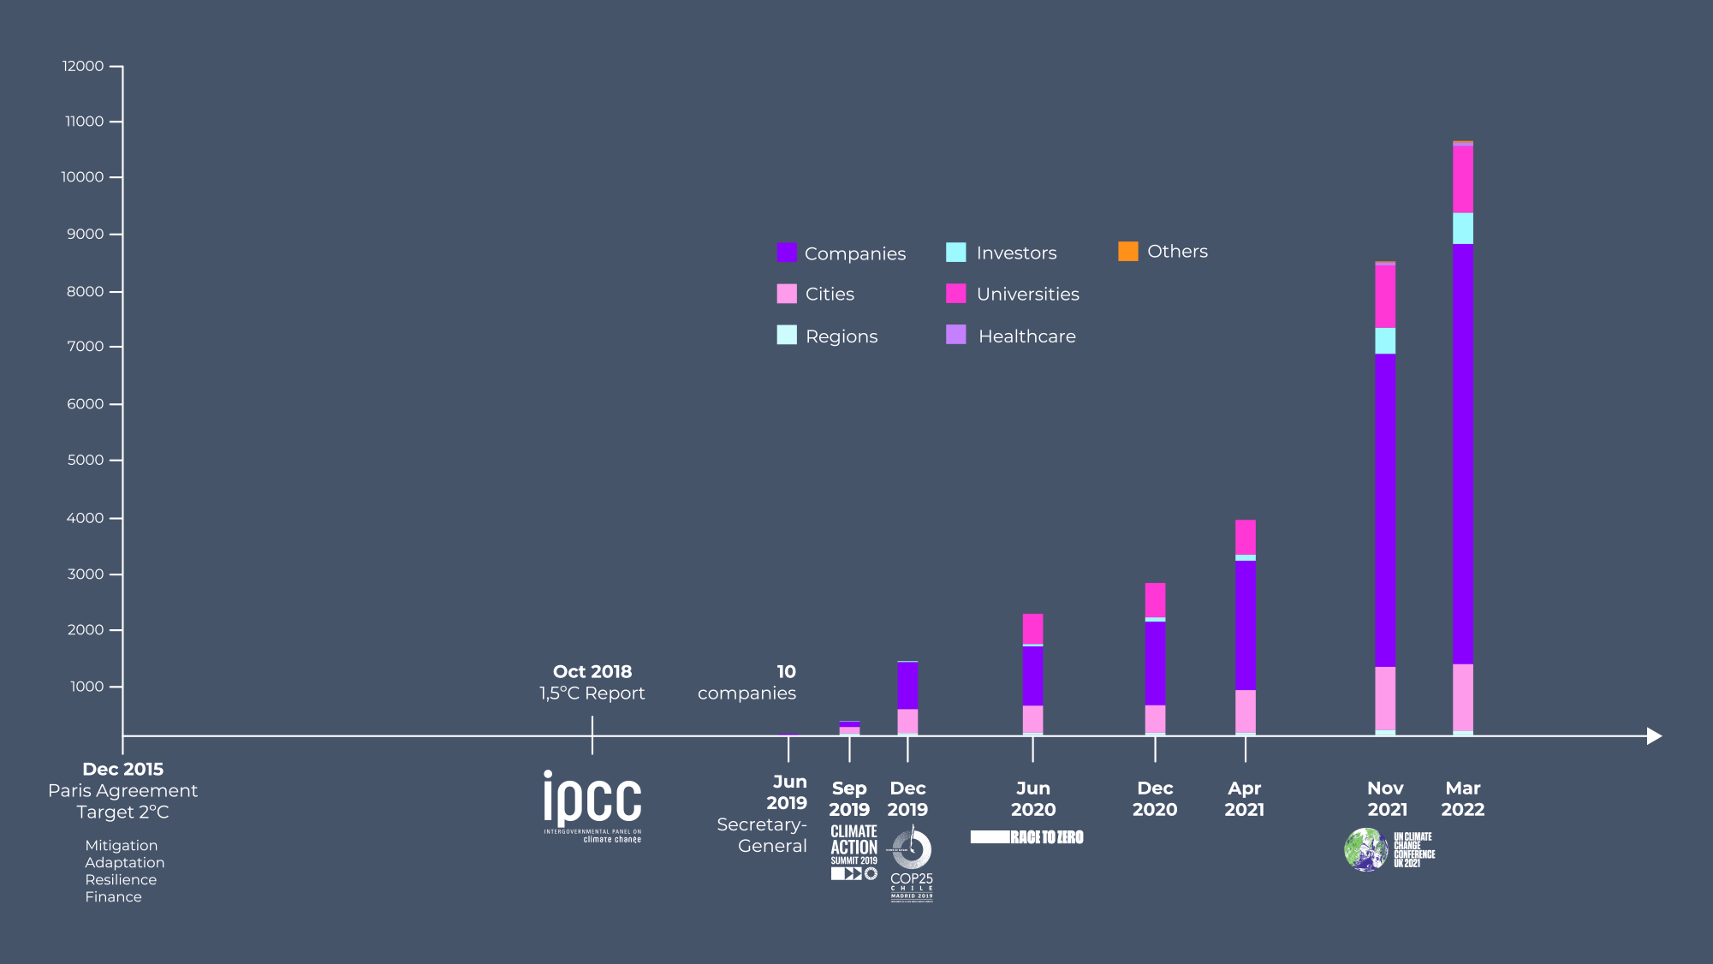
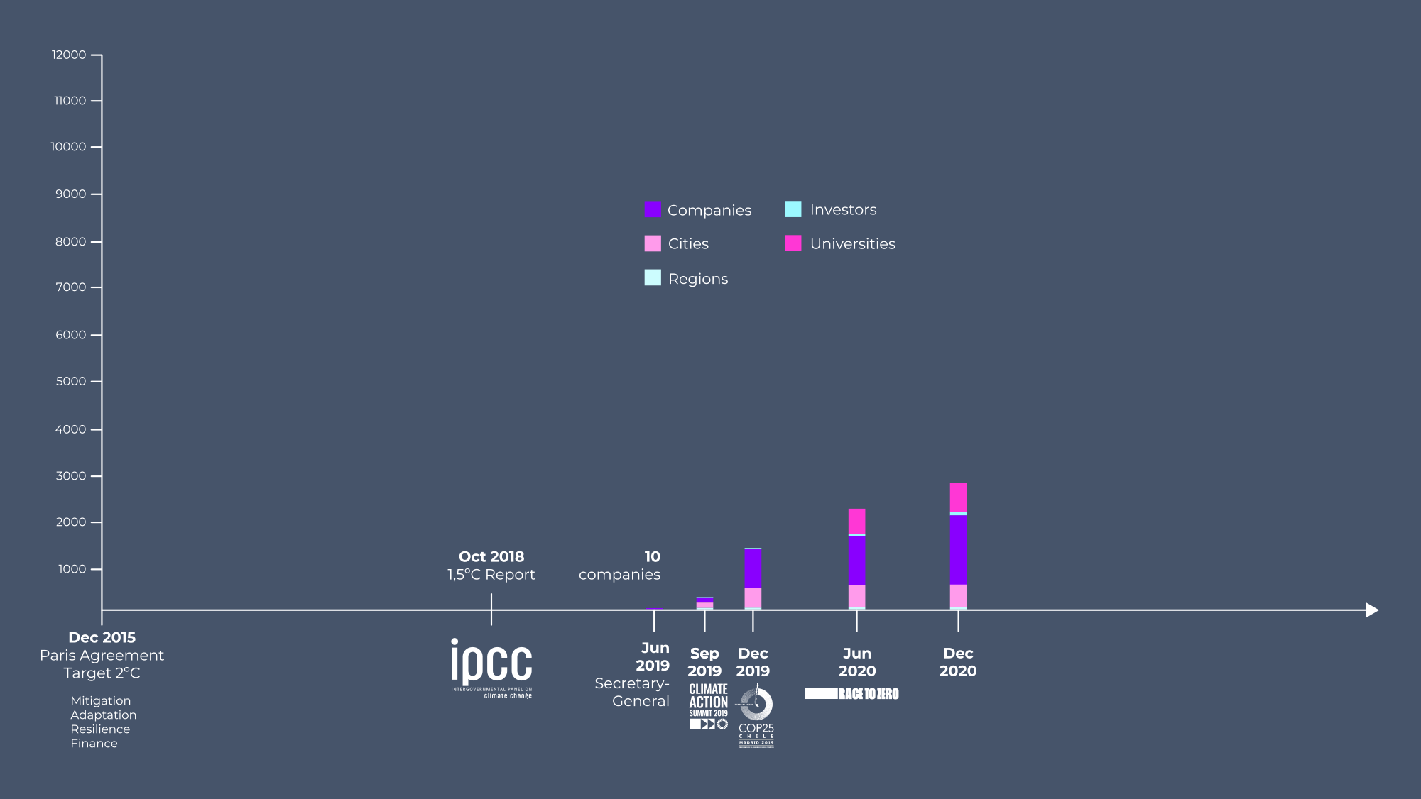

Slide 15
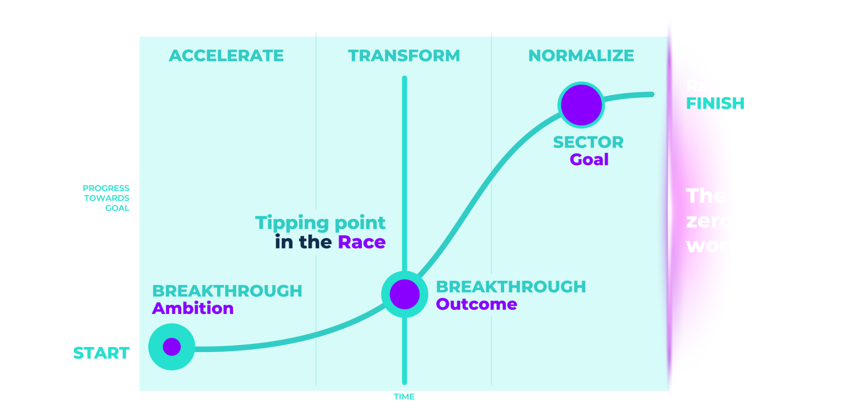
PROGRESS TOWARDS 2030
Enlace al documento completo aquí

Slide 16
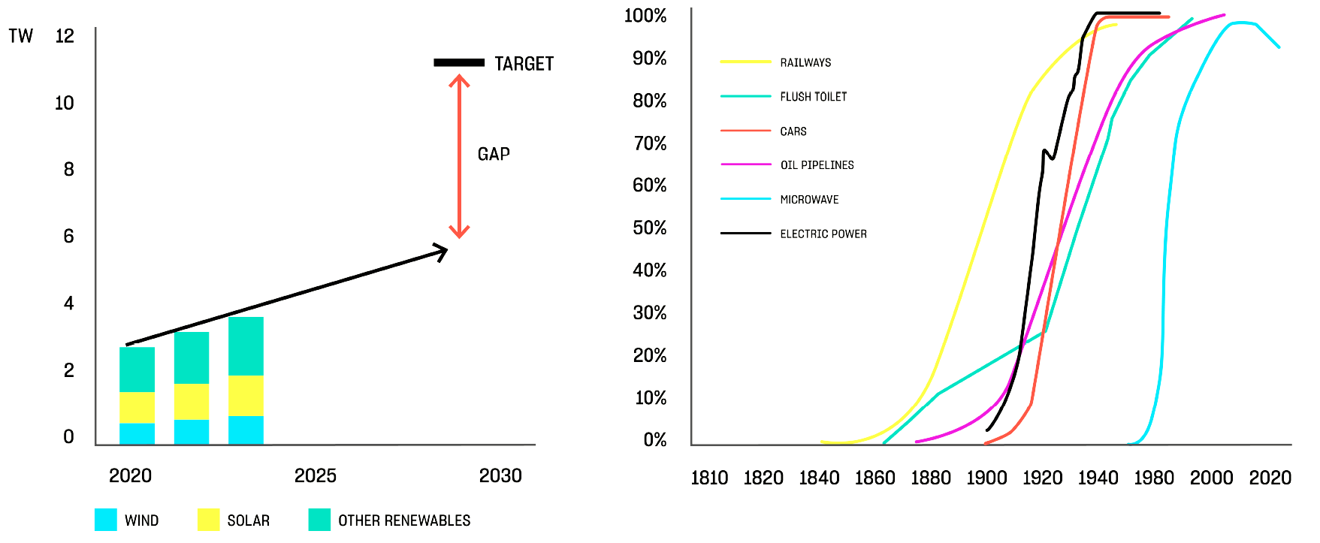
SHIFTING MINDSETS FROM LINEAR TO EXPONENTIAL
We expect change to continue at
the same speed as in the past
But change happens exponentially —
and has done for centuries
NEW GENERATION
CAPACITY

Slide 17
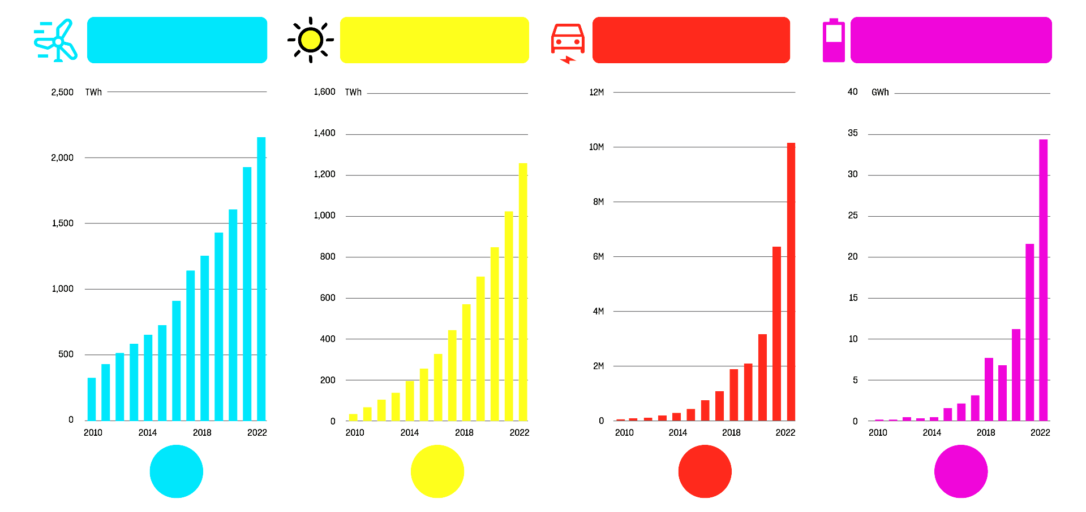
EXPONENTIAL GROWTH IS UNDERWAY FOR
RENEWABLE TECHNOLOGIES
WIND GENERATION
SOLAR GENERATION
ANUAL EV
SALES
ANUAL BATTERIES
SALES
15%
29%
58%
54%
Source: RMI Renewables Revolution, 2023. Global data from BNEF, BP, Ember.

Slide 18
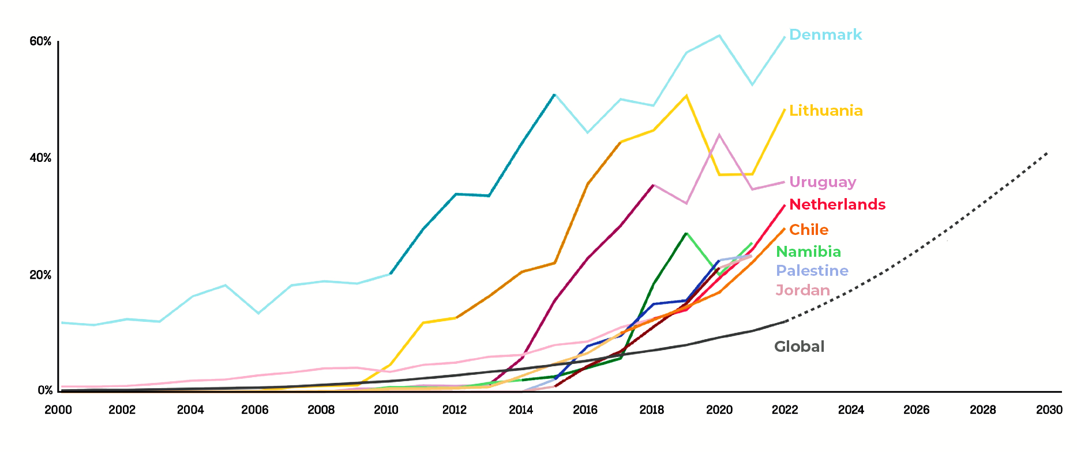
THESE 8 COUNTRIES HAVE ALREADY GROWN SOLAR AND WIND
AT STEEPER RATES THAN WHAT’S NEEDED GLOBALLY
Darker shades indicate fastest 5-year periods of growth
Solar and wind share of electricity generation
What’s needed
to stay on track
for net zero
Source: Systems Change Lab, based on historical data from Our World in Data, BP and Ember. Global target from IEA.

Slide 19
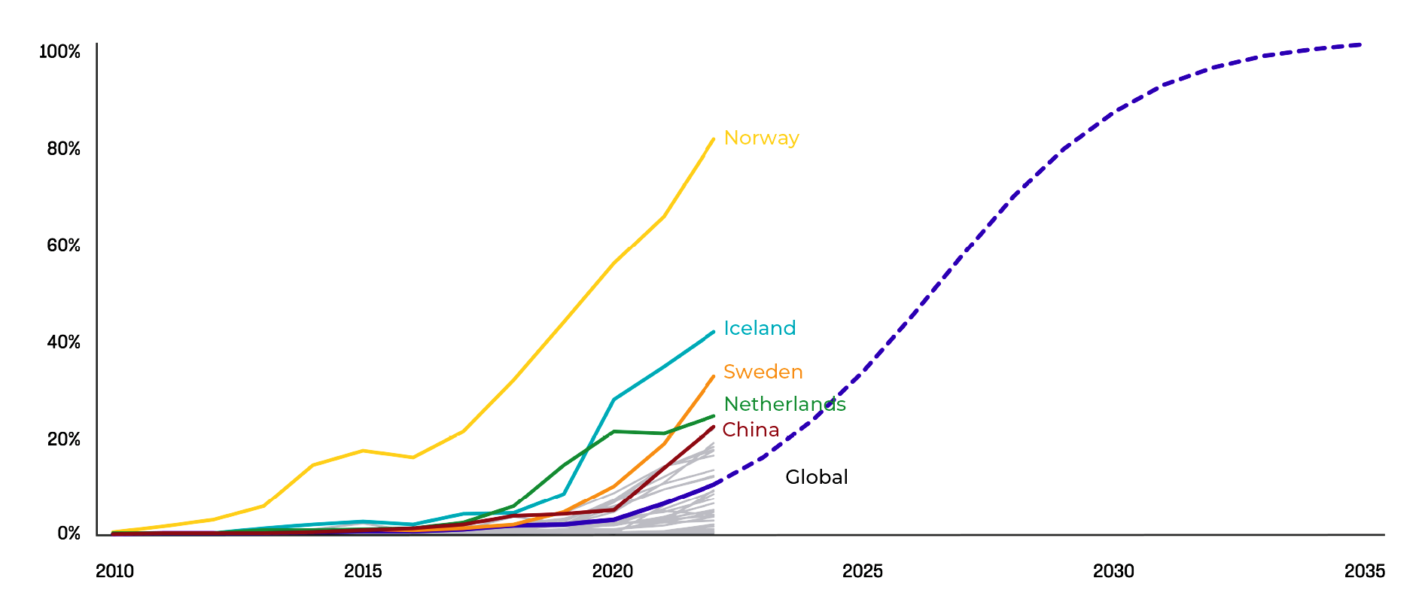
TOP 5 LEADERS IN EV ADOPTION HAVE FORGED A PATH
OR OTHER COUNTRIES TO FOLLOW
What’s needed
to stay on track
for net zero
EVs as share of passenger vehicle sales
Source: Systems Change Lab, based on historical data from IEA. Global target from Climate Action Tracker. Note: EVs include all-electric vehicles, not plug-in hybrid EVs.

Slide 20
EV HEADLINES TO PREPARE FOR
ICE FLEET, MILLIONS
MARCH 2025
The ICE car fleet has peaked
and is on the decline
NOVEMBER 2026
Global EV sales
surpass ICE sales
JANUARY 2040
Oil demand for cars set to
fully vanish in a few years
Source: RMI X-Change: EV 2023

Slide 21
EV HEADLINES TO PREPARE FOR
SHARE OF EVS IN CAR SALES, % OF TOTAL SALES
MARCH 2025
The ICE car fleet has peaked
and is on the decline
NOVEMBER 2026
Global EV sales
surpass ICE sales
JANUARY 2040
Oil demand for cars set to
fully vanish in a few years
Source: RMI X-Change: EV 2023

Slide 22
EV HEADLINES TO PREPARE FOR
CAR OIL DEMAND, MBPD
MARCH 2025
The ICE car fleet has peaked
and is on the decline
NOVEMBER 2026
Global EV sales
surpass ICE sales
JANUARY 2040
Oil demand for cars set to
fully vanish in a few years
Source: RMI X-Change: EV 2023

Slide 23
32 SECTORS
Aluminio
Aviation
Construction
Finance (banking)
Finance (asset management)
Finance (asset owners)
Finance (insurers)
Finance (service providers)
Fast moving consumer goods
Clean energy
Refrigeration
End of internal combustion engine (heavy vehicles)
End of internal combustion engine (buses)
End of internal combustion engine (light vehicles)
ICTs
Metals and mining
Mobile and telecommunications
Plastics
Retail
Fashion
Hydrogen
Maritime transport
Nature-based solutions
Pharmaceuticals
Oceans
Water
Oil and gas
Steel
Cement and Concrete
Chemicals
Tourism

Slide 24
Asset Owners
Banks
Asset Managers
Service Providers
Insurance
600
500
400
US$ 153.000.000.000.000
300
200
100
Sep 2019
Dec 2019
Dec 2020
Apr 2021
Nov 2021
Nov 2022

Slide 25
1972 - “HOUSTON, WE HAVE A PROBLEM!”
1992 - “HOUSTON, WE HAVE AT LEAST 3 PROBLEMS!”
2022 - “HOUSTON, WE HAVE AT LEAST 2 MORE PROBLEMS!”

Slide 26
GLOBAL PLASTIC POLLUTION AGREEMENT

Slide 27
30%
Global GHG emissions induced by food systems
Global food systems accelerate climate
change
Global deforestation driven by agricultural expansion
80%
86%
Of endangered species threatened by food systems
820M
Hungry people in the world
Food systems must be transformed to benefit people and the planet, adapt to 1.5°C and be resilient and equitable.
But it also fails to
feed all of us despite producing enough
3bn
People cannot afford a healthy diet
30%
Of total food production lost or wasted
20%
Decrease in agricultural productivity compared to a scenario without climate change
Left unchecked, climate change will worsen our prospects for achieving
global food security
40%
No decrease in crop yields by 2050
25%
Loss of value for major agricultural and food companies, if no action is taken
Source: Poore & Nemecek (2018); FAO Aquastat data (2017); Pendrill e.a. (2019), FAO (2015, 2020, 2022), World Resources (2018), IPCC 6th Assessment Report (2022); UN

Slide 28
EL FUTURO YA ESTÁ AQUÍ
SÓLO QUE NO ESTÁ DISTRIBUIDO UNIFORMEMENTE

Slide 29
POLI CRISIS
ES TIEMPO DE ACTUAR
NOVIEMBRE, 2023

